Slide 1
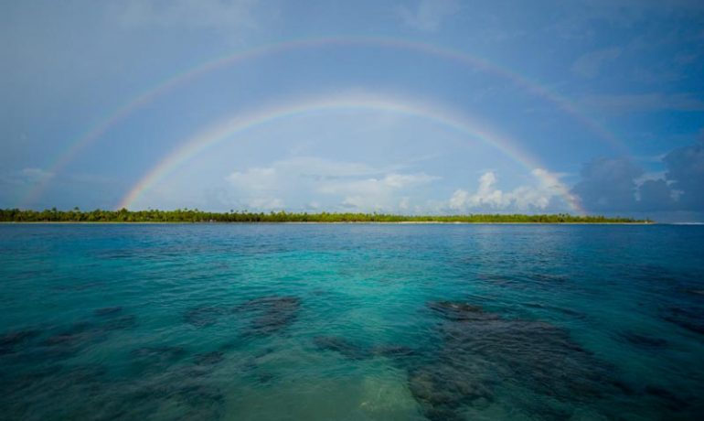

World Cargo Pacific
Company Profile

Slide 2
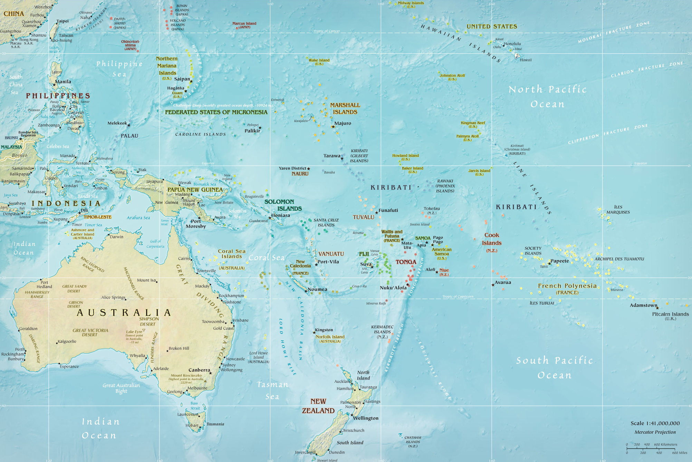
World Cargo Pacific
World Cargo Pacific (WCP) is your personalised and worldwide freight consultant into the Pacific Islands.
We are a young, and dynamic company offering a personalised and professional service in international freight forwarding since December 2014.
Specialising in Consolidation services worldwide into the Pacific Islands as a niche market; while at the same time, we handle any cross trade shipment worldwide and to/from New Zealand.
At World Cargo Pacific, we understand the importance of technology; an accurate and rapid flow of information is a critical requirement to ensure the smooth and predictable movement of freight. At the center of our technology strategy is the world’s leading logistics solution, CargoWise One from WiseTech Global.
The CargoWise One system is a complete global freight solution to manage bookings, local cartage, transport, shipping, customs, warehousing and more. World Cargo Pacific exchanges data in real time with our agents, customers and other partners, enabling us to provide the very highest level of service.

Slide 3
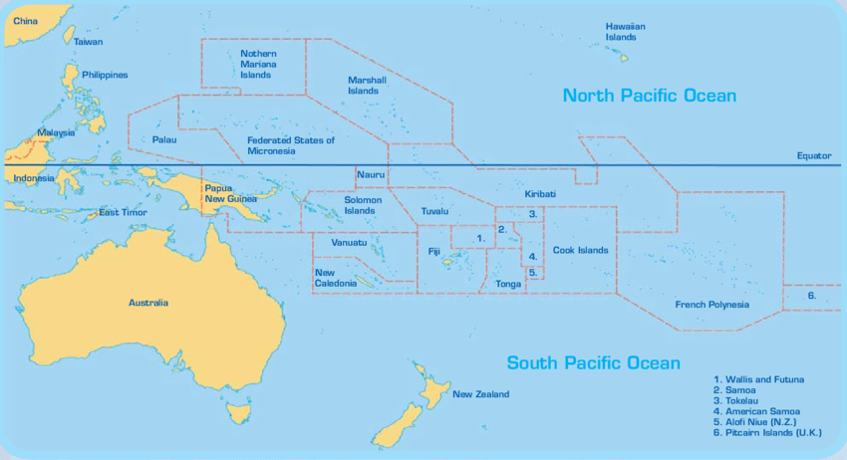
Mission Statement
Our customers are the main reason for our existence and we intend to keep them thoroughly satisfied by operating in a manner that furthers their business interests.
WPC is your personalised and worldwide freight consultant for the pacific Islands. We have the service experience and expertise to securely deliver your goods on time and to budget.

Slide 4
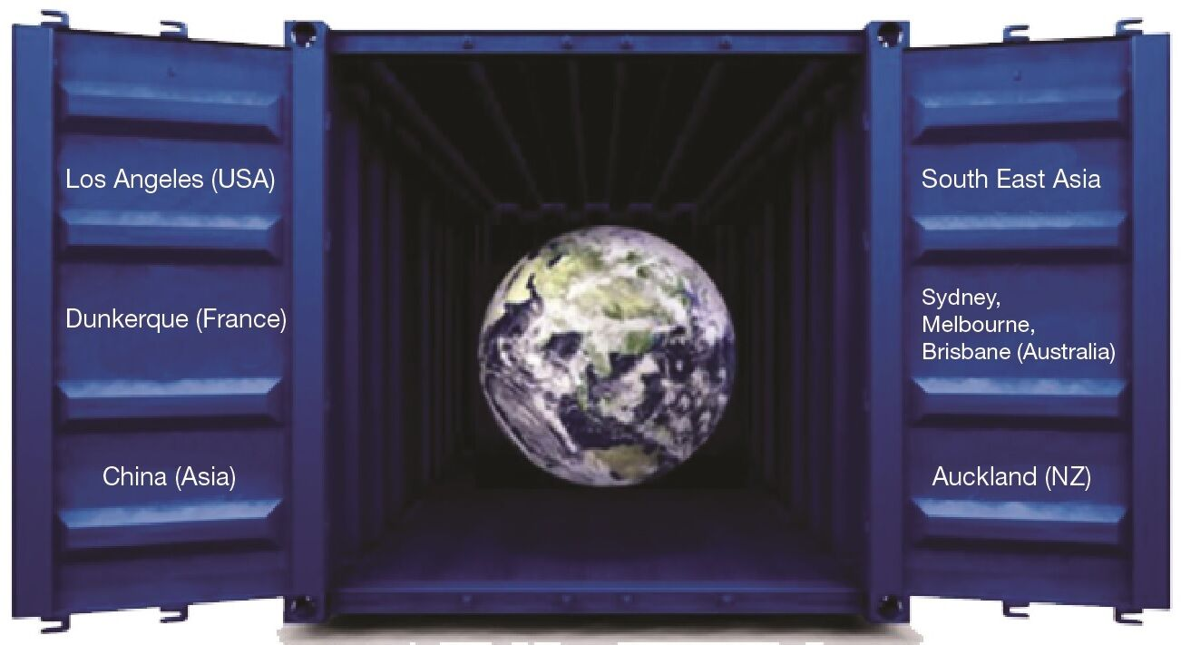
Pacific Specialist
We are specialising in Consolidation services worldwide into the Pacific Islands, while at the same time we handle any cross trade shipment worldwide and to/from New Zealand.
Our customers can reduce their shipping costs by combining their freight with other companies freight on the same transport.
Freight consolidation services give you the option of paying only for the space your cargo actually needs.
Stop wasting money on empty transport space!

Slide 5

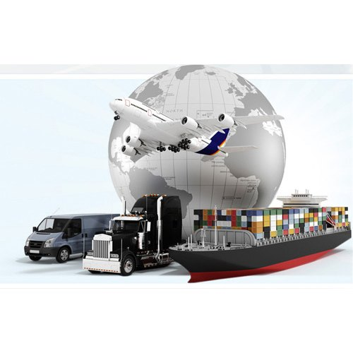
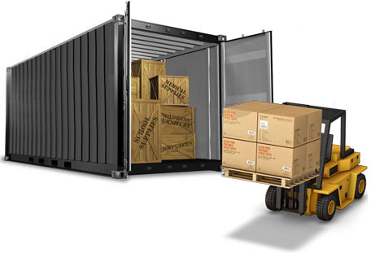
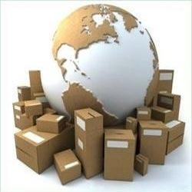
Service Consolidation
Scheduled Consolidation Services
Less than Container Loads (LCL)
Groupages Services
FCL Buyer Consolidations Services
LCL Seafreight Trans-shipment Services
Air / Air & Air / Sea trans-shipment
Outremer Fret Website

Slide 6
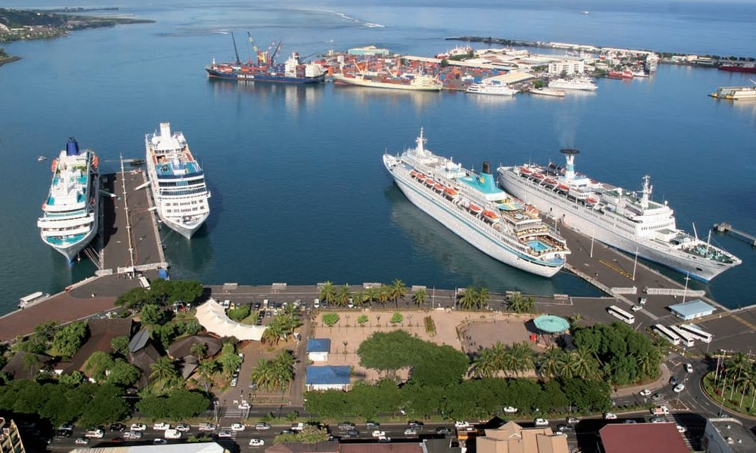
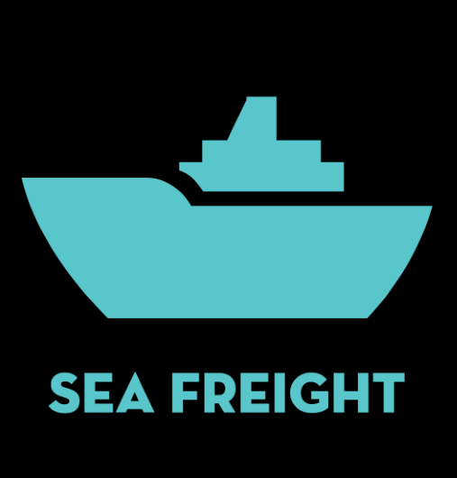
Transport Sea Freight
Documentation Handling & Processing
Imports & Exports services
Full Container Loads (FCL)
FCL Buyers Consolidations
Breakbulk Services
Port to Port services
Door to Door services
Cross-trade Seafreight shipment
Containers Packing & Unpacking
Dangerous Goods Management
Projet Cargo/Exhibitions
LCL Groupage Consolidation Reefer (surgeles) service ex Auckland to Papeete

Slide 7
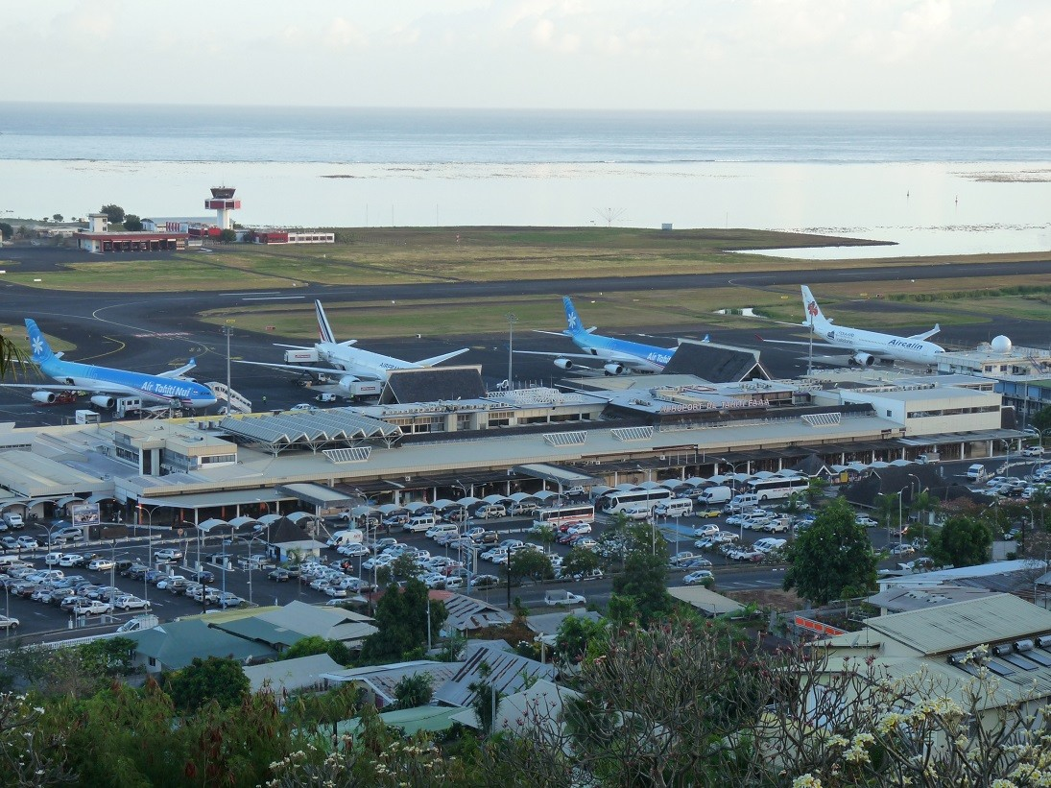
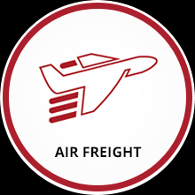
Transport Air Freight
Door to Door Services
Airport to Airport Services
Import & Export Shipments
Dangerous Goods
Transhipment Handling
Documentation Handling & Processing.

Slide 8

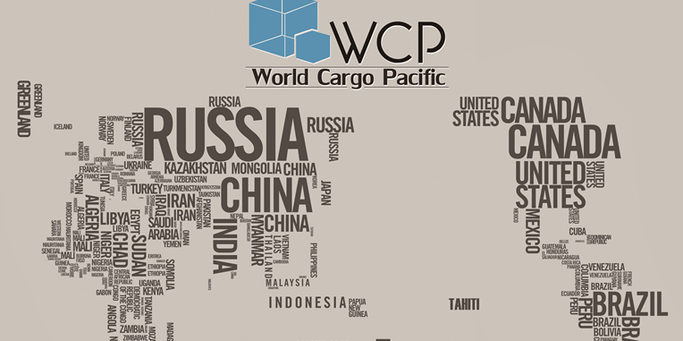
World Cargo Pacific “Tracking”
Via our Worldwide network of international agents in Asia, Europe, USA, South America, Africa, Middle East, Australia, New Zealand, your merchandise will transit DIRECTLY from port or airport to your French overseas territories destinations (TOM).
With WCP Tracking, our customers can be confident that their goods are in safe hands. We provide to our customers with 24/7 access to tracking information through a feature-rich online portal. Give our customers real-time visibility and you give them the peace of mind that their shipment is on target and on time. Offering web tracking as a powerful business driver has never been simpler.

Slide 9



Corporate Culture and Structure
World Cargo Pacific with 15 years experience & knowledge of the Pacific Island market.
Moreover, the world is our home because we are agent partners all over the world with local understanding capability, local logistics services, customs services and global e-commerce solutions.
We speak English!
Nous parlons Francais!
Hablamos Espanol!

Slide 10









Our Partnerships

Slide 11

Location
Office New Zealand: 16/203 Kirkbride Road, Mangere Po Box: 73045 Auckland Airport 2150.
Email: exports@worldcargopacific.com
Phone: +64 9 972 0460
Fax: +64 9 972 0474
After hours tel: +64 21 028 35618 or +64 21 048 9457
Office Tahiti: 15 rue du Dr Cassiau B.P. 44361 Papeete – Tahiti
Email: operations@worldcargopacific.com
Phone: (+689) 40 42 99 60
Fax: (+689) 40 43 99 60

